Slide 1


Slide 2

Ultimate productivity
for Semantic Models in Fabric Workspaces

Slide 3

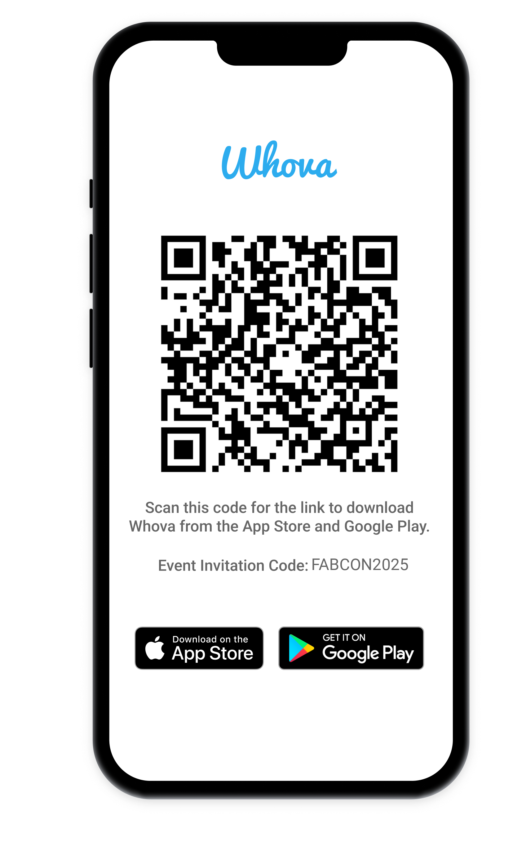
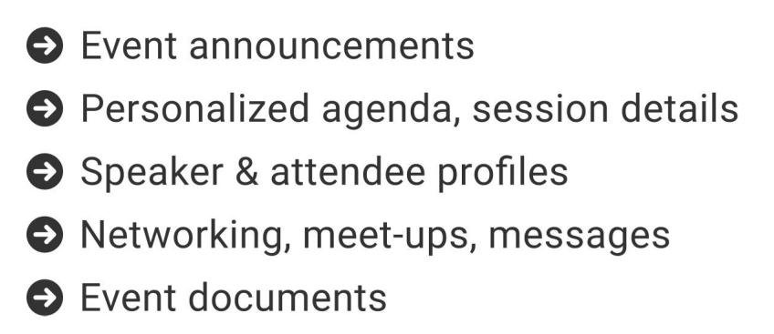
The official event app for the
Microsoft Fabric Community Conference
Join the event app to access:
Event Invitation Code: FABCON2025

Slide 4



Ultimate Productivity for Semantic Models in Fabric Workspaces
Daniel Otykier
Former Data and Analytics consultant
CTO of Tabular Editor ApS
Microsoft MVP and Power BI Contributor
Notes:
Welcome to the session where git meets Semantic Models – and they actually get along!
I’m Daniel – author of Tabular Editor and a Microsoft MVP. And I believe I’m also allowed to call myself “Power BI Contributor”, thanks to some work I did on allowing External Tools to register shortcuts in Power BI Desktop

Slide 5
A brief history of time
Semantic model development through the years

Slide 6
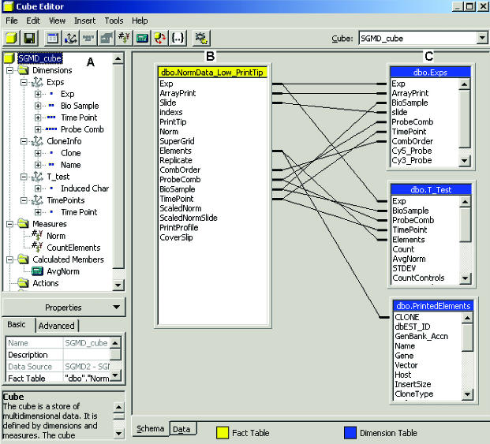

The very early days (2000-2012)
SQL Server Analysis Services
“Cubes”, “Multidimensional models”
“MOLAP / ROLAP / HOLAP”
Was version control even invented back then?!?
Notes:
Blissful ignorance

Slide 7
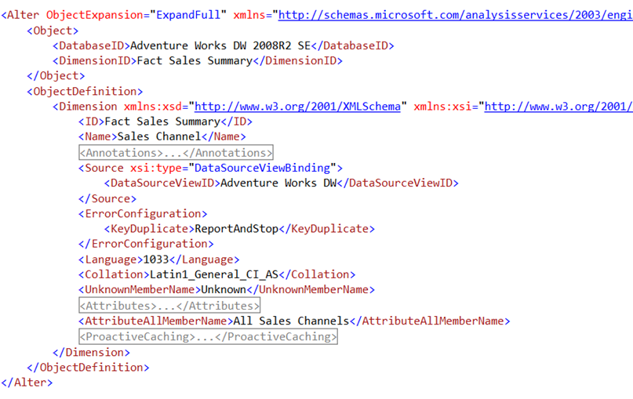

The early days (2012-2016)
“Tabular models” (VertiPaq)
XMLA based model metadata
Notes:
With the popularity and adoption of tabular models, increased need for version control
Ewww
Very git unfriendly
Very human unfriendly

Slide 8
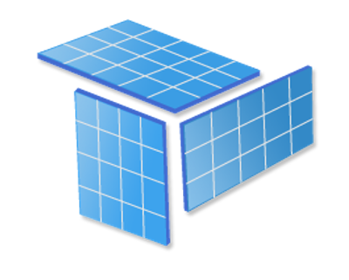


The Old Way™
Do I have the latest version?
Who overwrote my measures again?
Where did my changes go?
Why is this report broken in prod?
Tabular model
Notes:
Remember that time you renamed a measure, published it, and then found out your colleague had just renamed it to something else? Yeah, that was fun.
Semantic model development used to feel like assembling IKEA furniture without instructions… and blindfolded.

Slide 9
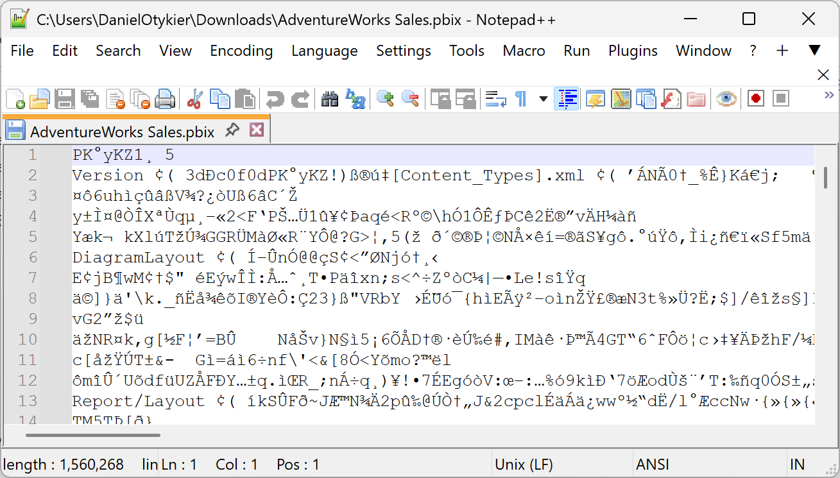

Power BI arrives (2015ish)
PBIX – binary, proprietary format
Not at all suited for version control
Notes:
With the popularity and adoption of tabular models, increased need for version control
Ewww
Very git unfriendly
Very human unfriendly

Slide 10
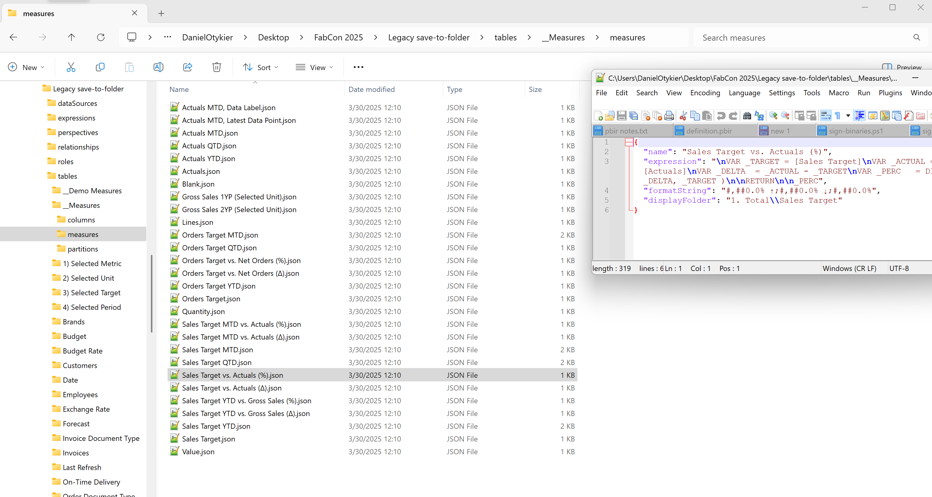

The more recent early days (2016+)
TMSL (JSON-based) model metadata
Tabular Editor “Save-to-folder”
Notes:
Not bad
Git friendly
Still not very human friendly

Slide 11
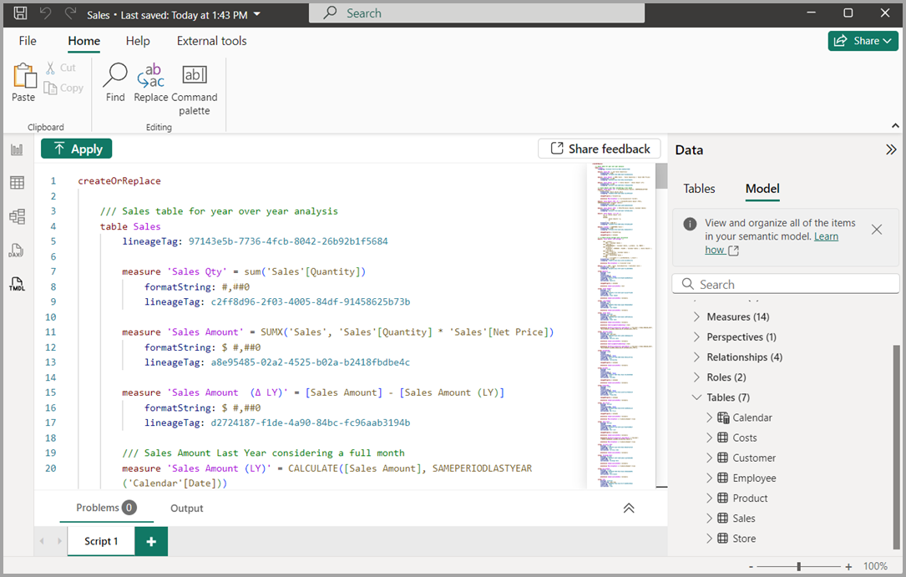

Recently
TMDL (yaml-like) model metadata
Supported by Power BI, Tabular Editor, and other external tools
Notes:
Yeah, now we’re talking!
But what about CI/CD, integration with Fabric workspaces, and other workspace artifacts? (reports, etc.)

Slide 12
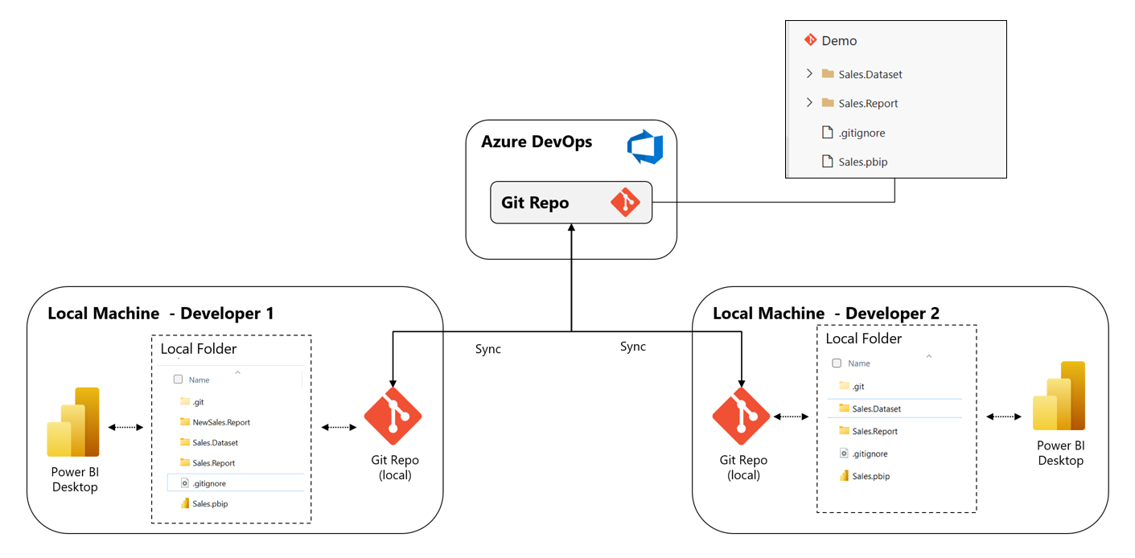

Now
TMDL and Enhanced PBIR in Fabric
Tabular Editor
https://learn.microsoft.com/en-us/power-bi/developer/projects/projects-azdo
Notes:
Mind blowing
Work with workspace artifacts (not just models and reports) as code – allows developers to use their preferred tool of choice
Programmatic generation of items and edit all item definitions
Streamline development workflows – enable large-scale collaboration on workspace content
Enables CI/CD on workspace content
Break things safely in dev/test environments – quality gates (code reviews, automated tests and build validation)

Slide 13
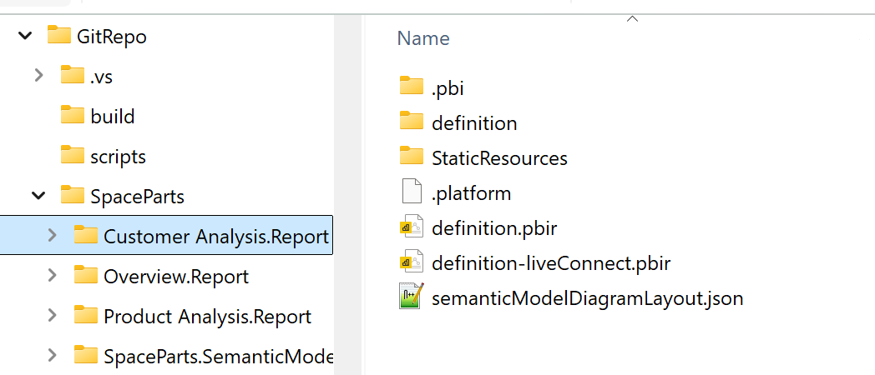
Main concepts
PBIP project folder structure (aka. “Developer Mode”)
Folder/file representation of your Fabric Workspace
TMDL and Enhanced PBIR
definition.pbir
specifies which model a report connects to
Useful for local development in PBI Desktop

Slide 14
Demo
Main concepts
Notes:
Show PBIP folder structure – how to set up PBIP with Desktop, TMDL and Enhanced PBIR
Show definition.pbir vs. definition-liveConnect.pbir
Show git repository Azure DevOps – show branch policy on main
Show integration of git on a Fabric workspace

Slide 15
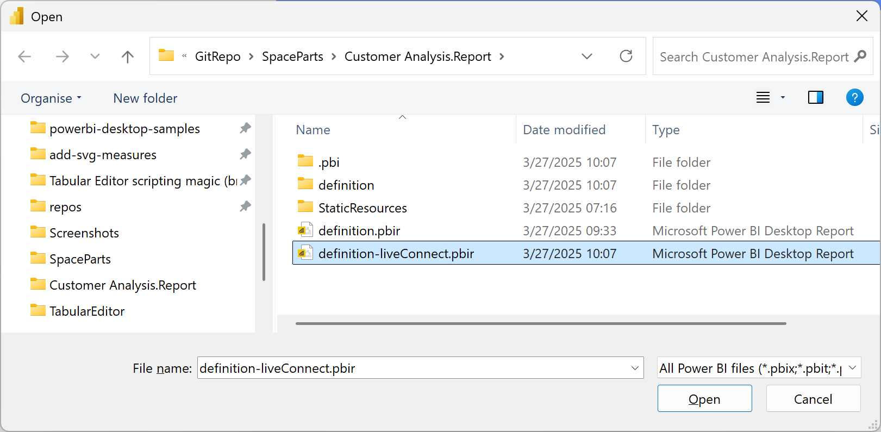
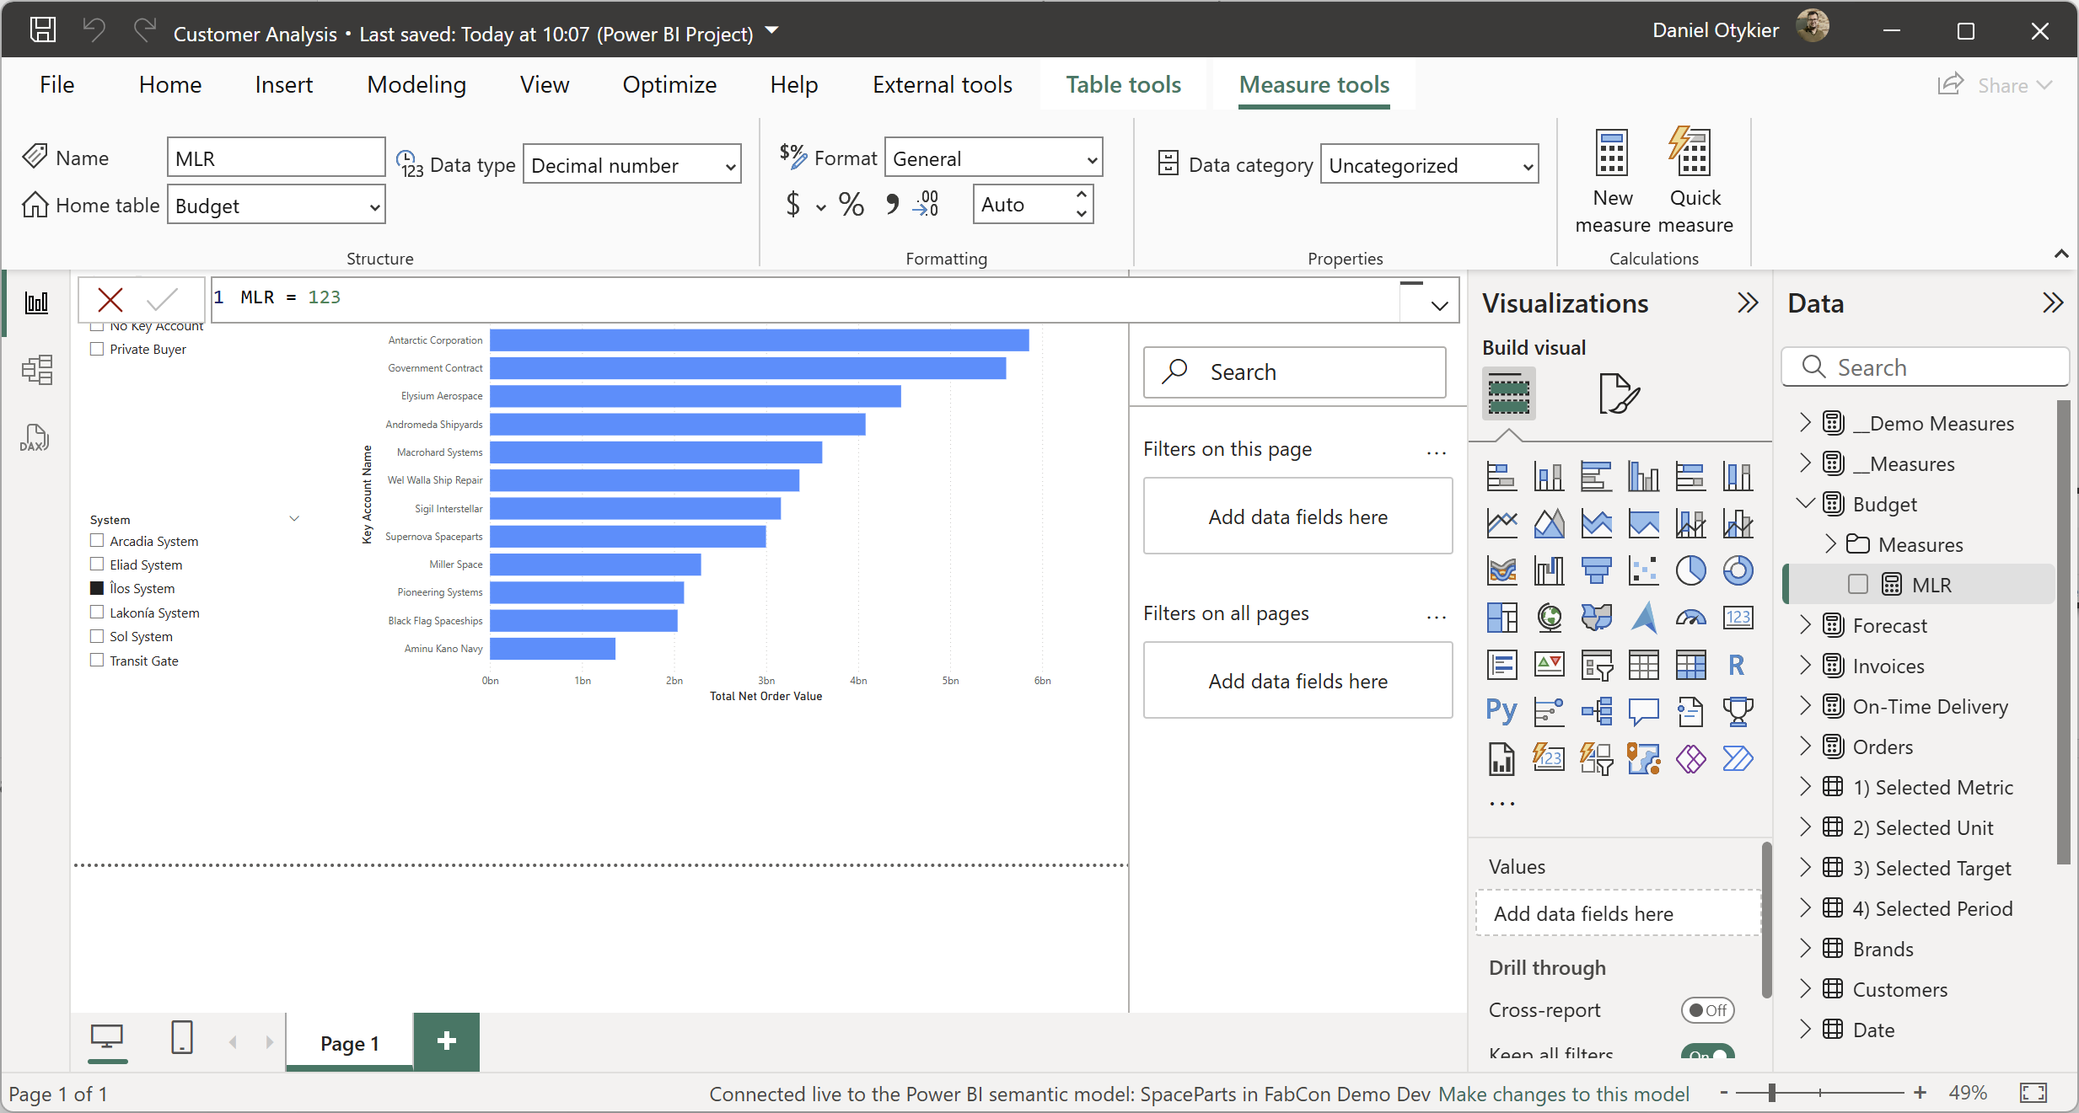
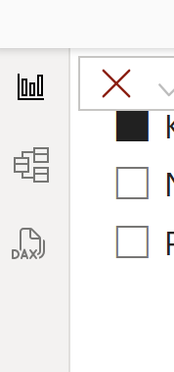
Gotcha: Report Level Measures
Only editable when report in “Live connect” mode
Need separate definition.pbir that uses a “byConnection” dataset reference (Fabric will always use “byPath” for semantic models in the same workspace)
Can have several additional .pbir files in the report folder
End up in reportExtensions.json

Slide 16
Gotcha: No standalone model editing in PBI Desktop
Power BI Desktop does not the support the .pbism file type
You always need a (dummy) report to open a semantic model in PBI Desktop

Slide 17
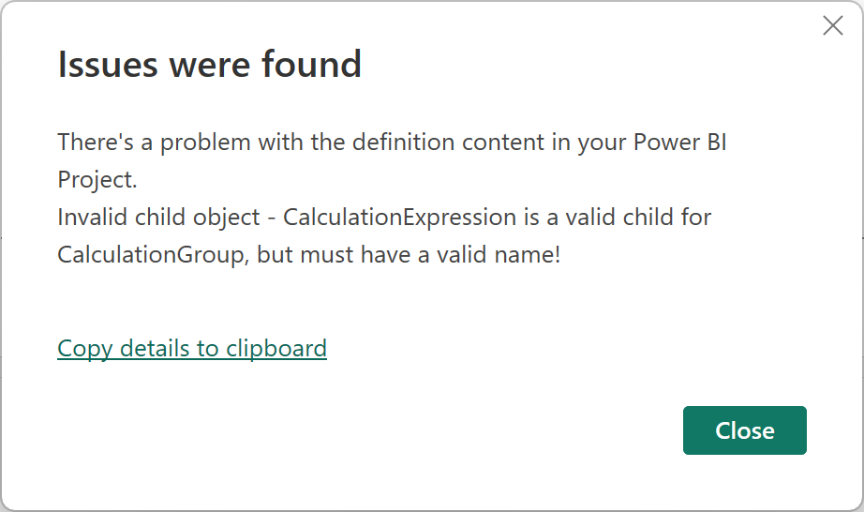
Gotcha: Careful when syncing from workspace to git
Unexpected Semantic Model metadata changes (System-authored DAX expression?!?)
May cause issues on subsequent opening in Power BI Desktop…
Branch policies can prevent accidental sync’ing

Slide 18
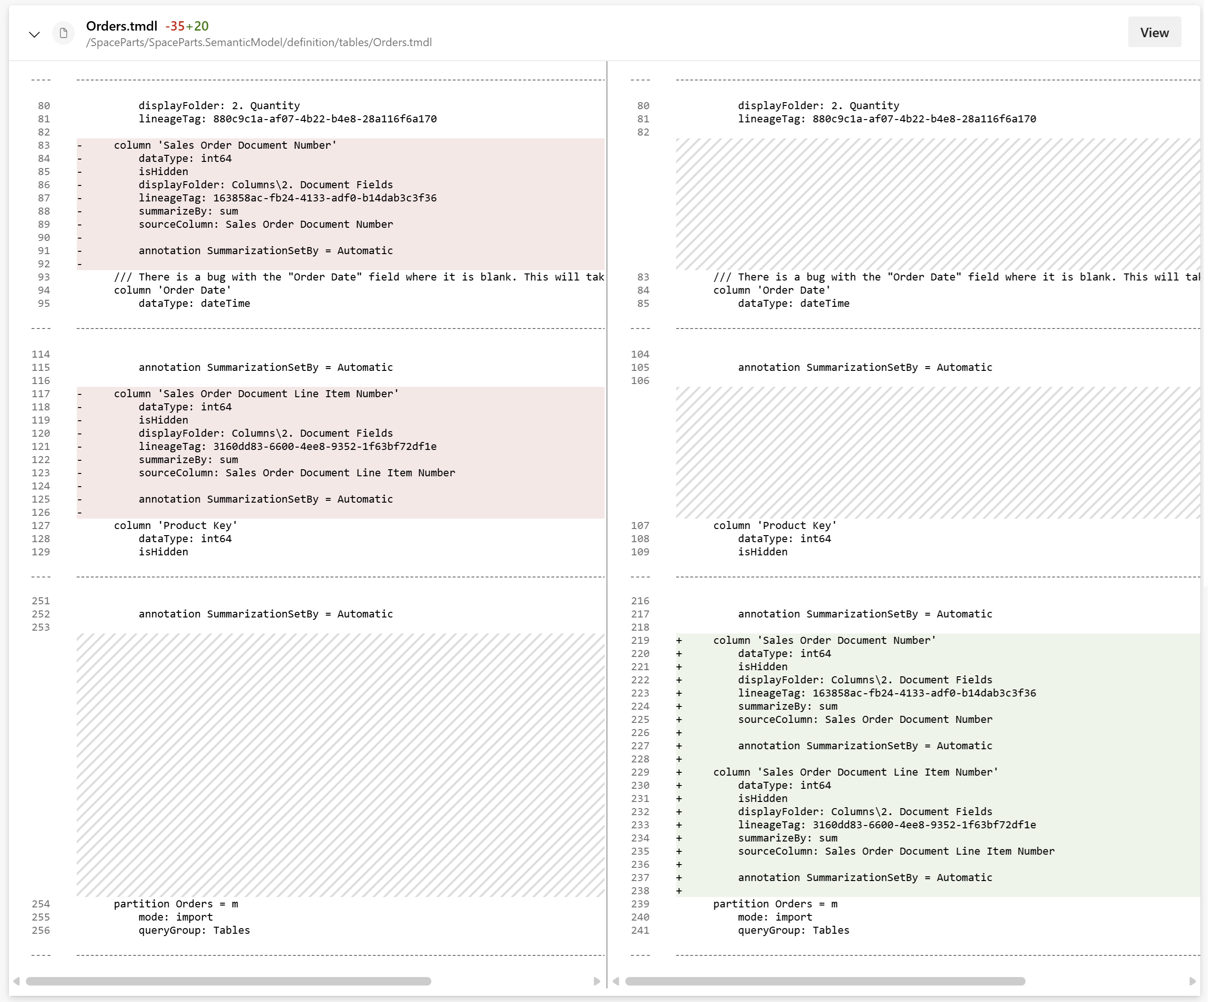
Gotcha: TMDL metadata order changes
Causes useless git diffs and potential merge conflicts
Can happen when…
Editing semantic model through XMLA and syncing to git
Opening model + report in PBI Desktop and saving
Consider “disconnecting” report from model
Notes:
Power BI Desktop and the Power BI service does a lot of validation and may change various objects, annotations, etc. every time you make a change to your model. On the contrary Tabular Editor only makes metadata changes to the objects that you explicitly modify in the UI.

Slide 19
Pro tooling
Tools for Power BI developers who want to be more productive

Slide 20
Many options – one size rarely fits all
Power BI Desktop: DAX Query View, TMDL View
Power BI service web modelling
Semantic Link Labs
Tabular Editor (2 or 3)
VS Code
…more will surely come

Slide 21
Demo
Semantic model development with TMDL view

Slide 22
Demo
Semantic model development with Tabular Editor

Slide 23
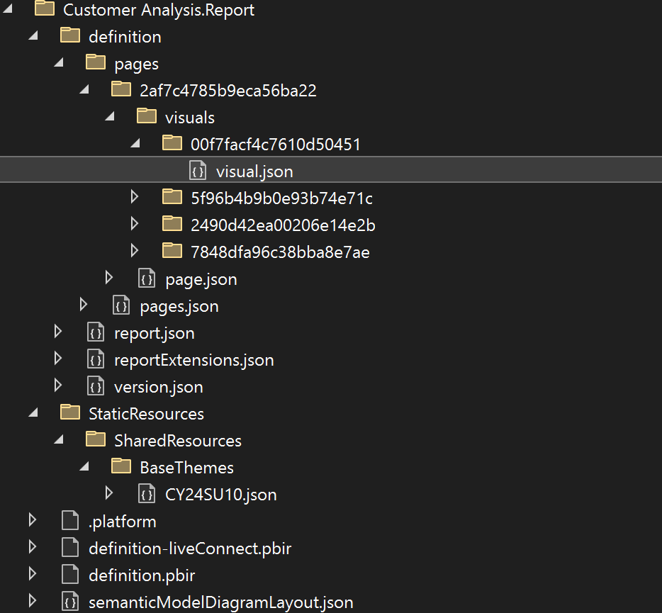
Power BI Reports
Tightly coupled to semantic models
Use Enhanced PBIR
JSON with publicly available schemas
Separate files per visual
Enables scripting and programmatic access
JSON schemas enforce syntax, but not semantics!
Dear Santa. All I want for Christmas this year is an API for Enhanced PBIR.
Notes:
Previous demo focused on the Semantic Model metadata. However, there is another artifact in a Power BI workspace which is tightly coupled to the semantic model. That is of course the report. It’s tightly coupled because it’s explicitly referencing objects in the semantic model by name. This means that the semantic model exposes an interface and any changes to this interface may cause connected reports to break.
With Enhanced PBIR it’s much easier to make sense of the report metadata. However, the JSON schemas only specify syntax elements – not semantics, so it’s still possible to have a report that refers to a measure that doesn’t exist in the model.

Slide 24
Demo
Breaking stuff
Notes:
So now that we know what Enhanced PBIR is – let’s go break some stuff

Slide 25
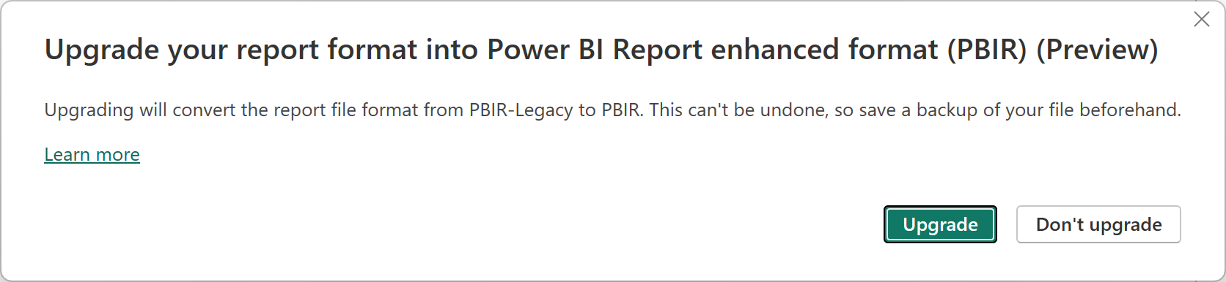
Gotcha: PBI Service uses “PBIR-Legacy”
PBI Service writes old JSON format for report/visual metadata
Horrible to work with programmatically...
Can be upgraded through Power BI Desktop
PBI Service works fine with enhanced PBIR from git

Slide 26
Deployment and collaboration

Slide 27
Deployment options
Option 1: Fabric Deployment Pipelines
Option 2: Fabric Git integration
Option 3: Fabric REST APIs
All of the above can be orchestrated in Azure DevOps / GitHub actions CI/CD pipelines
https://learn.microsoft.com/en-us/fabric/cicd/manage-deployment
Notes:
In order to orchestrate from CI/CD pipelines, use REST APIs, PowerShell, or

Slide 28
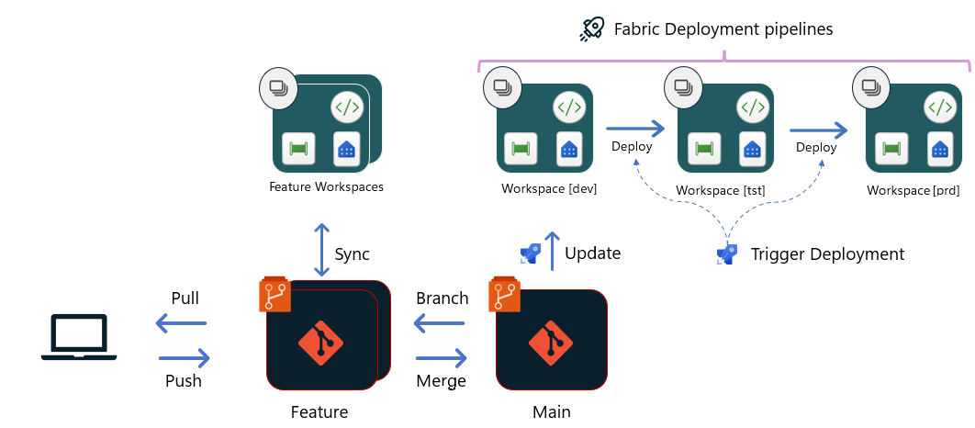
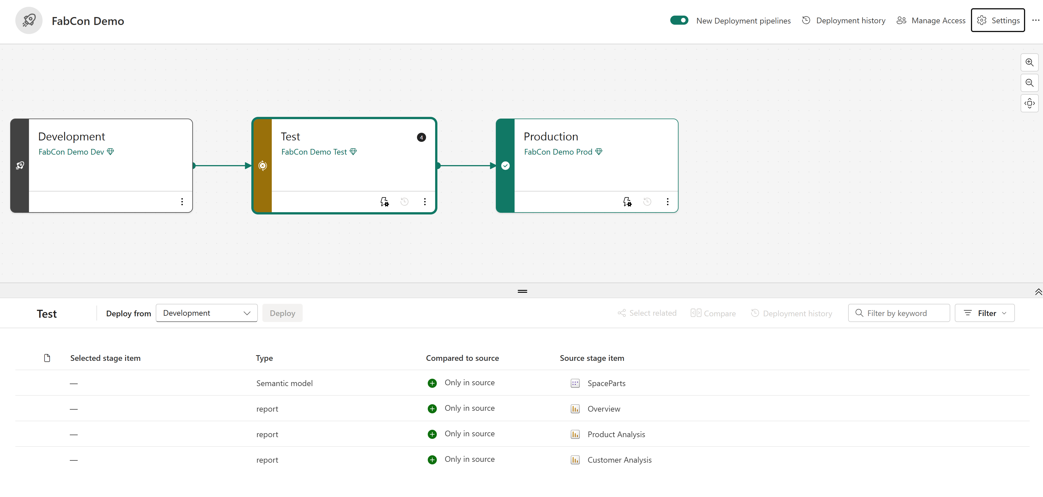
Option 1: Fabric Deployment Pipelines
Easy to set up and use – even if you’re not using git
Some flexibility with deployment rules, autobinding, pairing
Notes:
Pairing:
- Occurs when items are copied from one stage to another using the “Deploy” option
- Occurs when a workspace is assigned to a stage, if an item matches the type, name, and folder of the item in the preceding stage

Slide 29
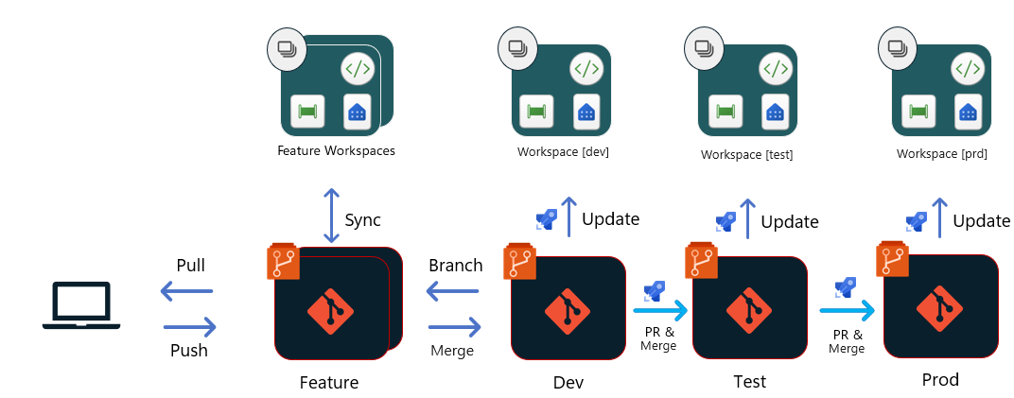
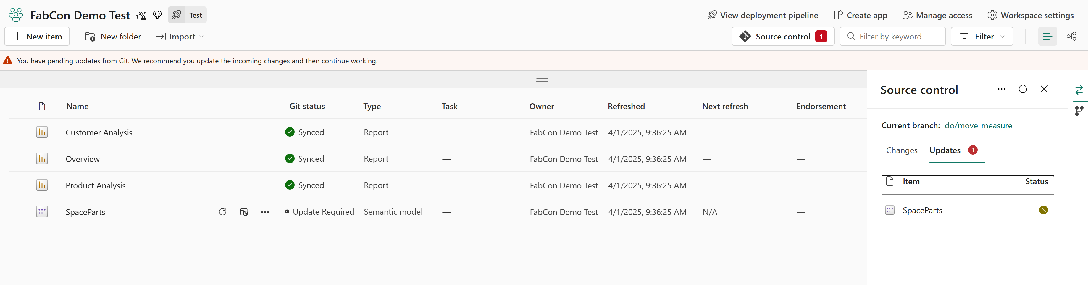
Option 2: Fabric Git integration
Git as the single source of truth
Requires a suitable branching strategy
Least flexible
Notes:
Suitable branching strategy: Gitflow, or another strategy with multiple primary branches (one for each deployment stage)

Slide 30
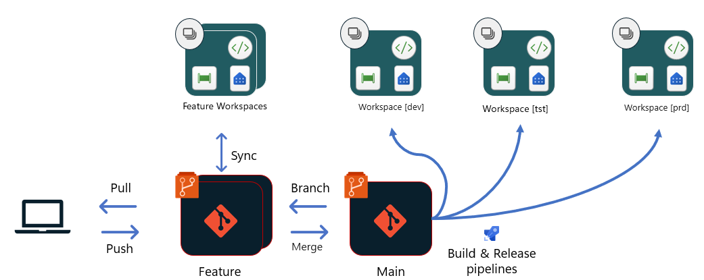
Option 3: Fabric REST APIs
Trunk-based development (i.e. one main/primary branch)
Explicit release pipeline in your CI/CD tool (can be PowerShell or Python)
Allows custom build/deployment scripts, etc.

Slide 31
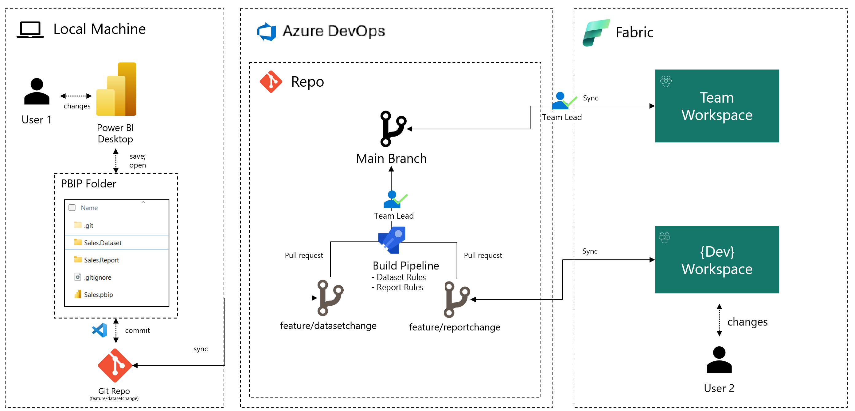
Parallel development best practices
(At least) one workspace per developer
Dev workspaces should not share capacity with Prod
Set up branch policies / quality gates / build validation
https://learn.microsoft.com/en-us/power-bi/developer/projects/projects-build-pipelines

Slide 32
In conclusion
Pro Power BI development finally possible!
Thanks to PBIP (TMDL + Enhanced PBIR)!
Power BI artefacts integrate better with version control
Enables more collaboration, quality gates
More, better support for external tools
More productive development
More deployment options

Slide 33
Scripts used in demos
C# script for generating measure descriptions through Open AI
C# script for validating measure references in Power BI reports (enhanced PBIR)
Yaml definition of Azure DevOps pipeline that:
Downloads Tabular Editor 2
Runs the C# script to validate measure references in reports
Runs the Best Practice Analyzer
https://github.com/TabularEditor/Scripts/tree/master/Demos/FabCon%202025

Slide 34
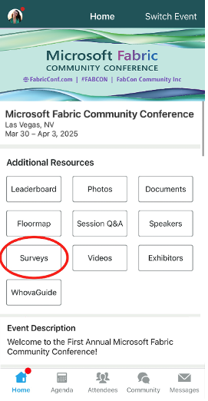
Session Feedback Surveys
We really want to hear from YOU!
In the pursuit of making next year’s Microsoft Fabric Community Conference even better, we want to hear your feedback about this session.
Here’s How -
Simply go to the Whova App on your smartphone
Scroll down on the Microsoft Fabric Community Conference Homepage to ‘Additional Resources’ to click “Surveys’.
Click Session Feedback.
Scroll down to find this session title.
Complete the session feedback survey.
Finally, click ‘Submit’
It’s just that easy!

Slide 35
